Slide 1
JAVA

Slide 2
FEATURES OF JAVA
Java is Simple.
Java is Object Oriented
Java is Distributed
Java is Architecture Neutral
Java is Robust
Java is Interpreted and Compiled
Java is Secure
Java is Portable
Java is Multi-Threaded

Slide 3
Difference between C++ & JAVA
JAVA | C++
Java does not support pointers, templates, unions, operator overloading, structures etc. | C++ supports structures, unions, templates, operator overloading, pointers and pointer arithmetic.
Java support automatic garbage collection. It does not support destructors as C++ does. | C++ support destructors, which is automatically invoked when the object is destroyed.
Java has built in support for threads. In Java, there is a Thread class that you inherit to create a new thread and override the run() method. | C++ has no built in support for threads. C++ relies on non-standard third-party libraries for thread support.
Java doesn't support multiple inheritance | C++ supports multiple inheritance
Java is platform-independent | C++ is platform-dependent

Slide 4
Java Development Kit (JDK)
JDK constitutes of tools like java compiler, java interpreter and many.

Slide 5
API
Java includes many development tools, classes and methods
Development tools are part of Java Development Kit (JDK) and
The classes and methods are part of Java Standard Library (JSL), also known as Application Programming Interface (API).
API includes hundreds of classes and methods grouped into several packages according to their functionality.

Slide 6
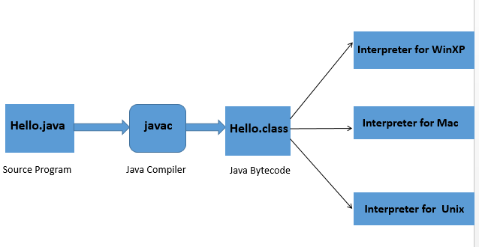
JAVA PROGRAM TRANSLATION

Slide 7
JAVA VIRTUAL MACHINE (JVM)
Java virtual machine is the like usual computer which translate high level language into machine language.
Just like that Java virtual machine also translate Bytecode into machine language.
JVM are available for many hardware and software Plateform.

Slide 8
